Slide 1

Analyzing the Sneeze Shield – A Deep Dive into the Facial Tissue Market
Group 1
Group 1

Slide 2

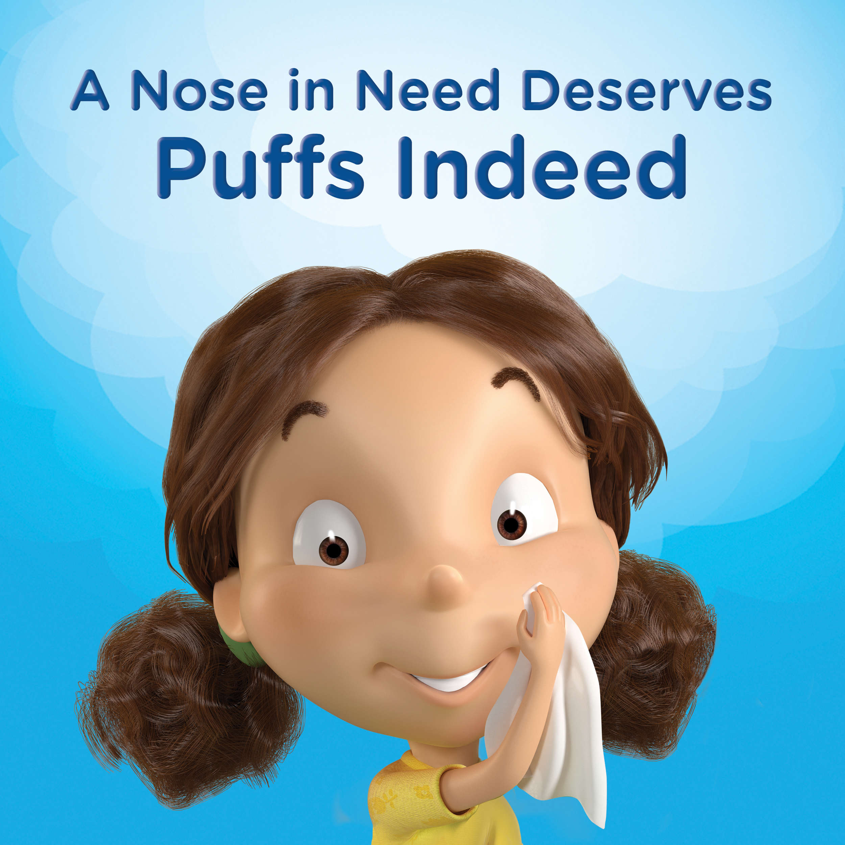



Objectives:
Who are our customers?
Who are our target customers?
How Demographic Affects Each Brand?
How promotion and display affect sales?

Slide 3
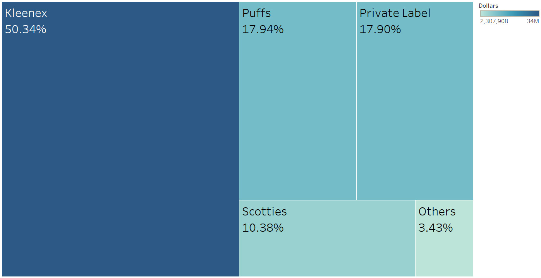
Market share

Slide 4
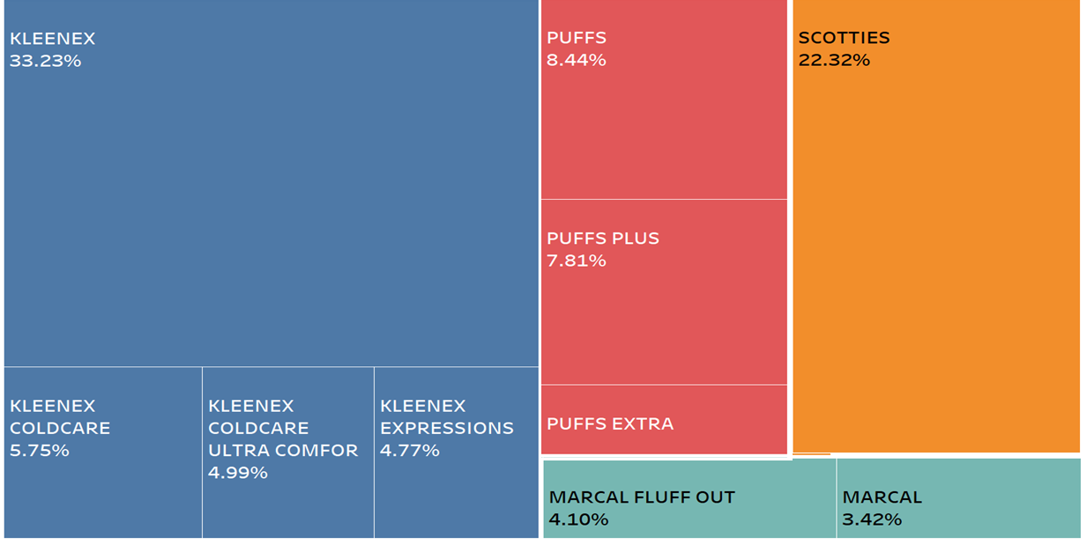
Dollar Sales:

Slide 5

Who do they prefer?
Who do they prefer?
Kleenex
Puff
Small Family (1,2,4)
All Male
Higher Combined Family Income
Race- White, African-American,
Younger Children
Mid Age Female
Female Homemakers and retired
Based on Multinomial Logit :
(Brand, products)= Family Size + Race + Children Age + Male Age Group + Female Age Group + No of Pets

Slide 6
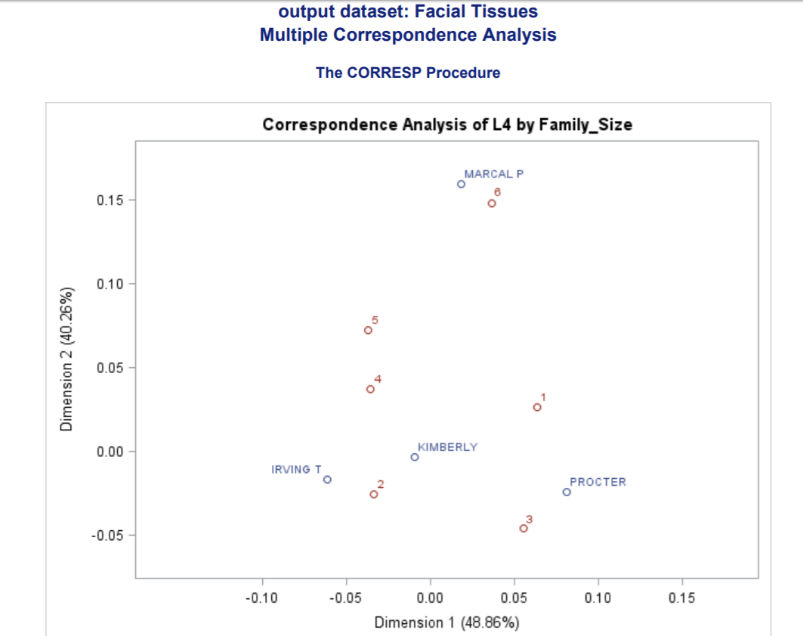
Multiple Correspondence Analysis

Slide 7
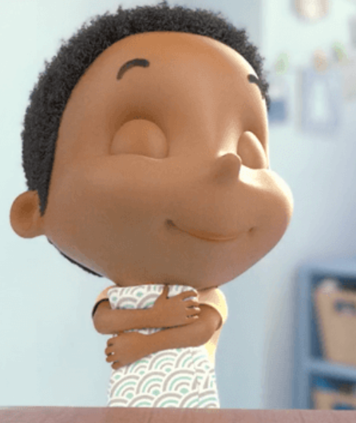
Who Are My Customers?
Based on the RFM scores we concentrate on our following customers:
Most Frequent Buyers
Most Recent Buyers

Slide 8
Customer Segmentation:
Customer Segment | Customer sub-segment | Recency Score Range | Frequency Score Range
Prime/Loyal Customers | Champions | 4-5 | 4-5
 | Loyal Customers | 2-5 | 3-5
Promising Customers | Potential Loyalist | 3-5 | 1-3
 | Recent Customers | 4-5 | 0-1
 | Promising | 3-4 | 0-1
About to Lose Customers | Customers Needing Attention | 2-3 | 2-3
 | At Risk | 0-2 | 2-5
 | Can’t Lose Them | 0-1 | 4-5
Lost | Hibernating | 1-2 | 1-2
 | Lost | 0-2 | 0-2
 | About To Sleep | 2-3 | 0-2

Slide 9
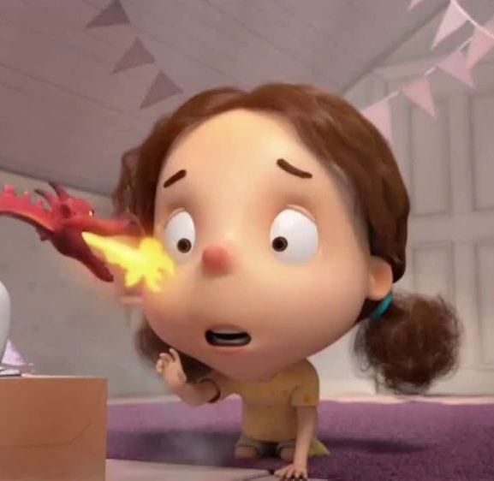
Unit Sales across different Customer Segments
Prime Customers -
Family with Younger Kids
Middle Age Female
Older Male
Race – White/African-American / Hispanic
Losing Customers -
Big Families
Younger Male
Unit(sales) (prime customers)= family size + Is pet + Children Age Group + Male Age Group + Female Age Group + Race
Notes:
Generally more likely

Slide 10
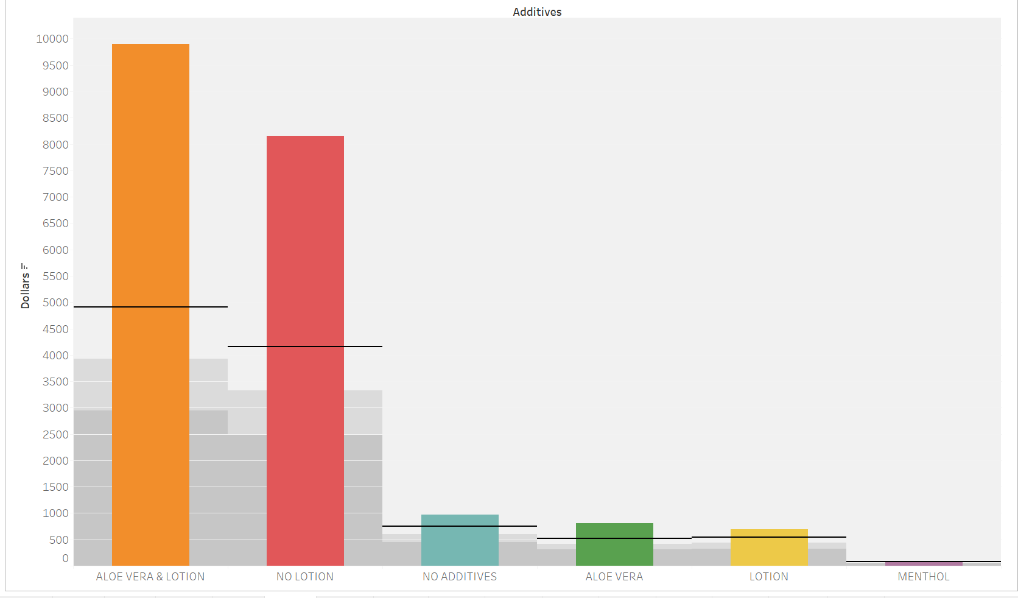
Puffs Features That are Driving Sales
2-ply tissues are more preferred over 3-ply
In Additives, Aloe vera and lotion over others
Notes:
Puffs Ultra Soft & Strong tissues, which are two-ply, bested all three-ply products in Consumer Reports’ tests and is aligned with our data as well.

Slide 11
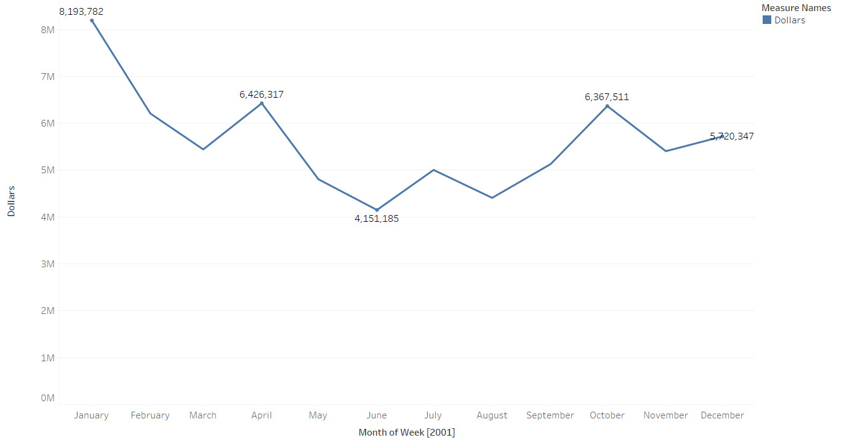
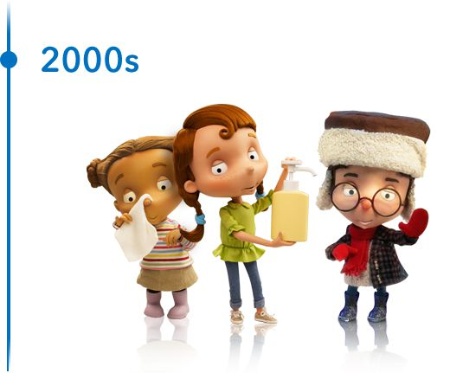
Nose In Need Deserves Puffs Indeed
Seasonal effect on Sales:

Slide 12




Effect of Display And Promotions On Unit Sales in top 50 stores
Synergy effect of Display and promotions by Scotties will reduce sales of Puffs by 6.9% when 10% more Scotties products are displayed
Unit sales are affected by Display of Kleenex by 4%
1% increase in price across puffs products then
unit sales will decrease by 4.8%

Slide 13
Recommendations
Puffs lacks in variety of the products, they should introduce the seasonal products like ColdCare and Ultra Comfort like Kleenex
Target Promising Customers to convert them into loyal customers by giving them coupons
We can build Look-alike Model for Identifying Similar Customers to the prime customers who haven’t purchased

Slide 14

Thank You

